Slide 1
Introduction to Measurements
Lecture – 1
V. Sugumaran

Slide 2
OBJECTIVES
Answer what is measurement & why it is necessary
Say why an Engineer needs to learn measurement
Describe what an instrument is & its basic functional block
Describe generalized measurement system
Identify the various units of measurement system
Describe different types of instruments

Slide 3
What is measurement?
“If you can express what you are talking about in terms of some number, then you know something about it” says Lord Kelvin and measurement is all about finding that number.

Slide 4
What is measurement?
Distance between home and office = n * m;
Where,
m - meter in this case (In general, unit).
n – is the number of times the unit occurs in the given distance.

Slide 5



Why measurement?
Lactometer
Clock
Thermometer

Slide 6


Why measurement?
To know/monitor the processes and operations through its parameters.

Slide 7



Why measurement?
Salt control
Size Control
Speed control
Here, the role of measurement is to control the processes and operations

Slide 8


Why measurement?
Physics Class
How do I Believe
This Man?!!
density as
mass per
unit volume
and
the density of
water is 1000 kg/m3

Slide 9

Why measurement?
He uses the equation
Mechanics Class
we can predict
the maximum
height traveled by
the stone provided
it is thrown vertically
up and with
known velocity.
Where,
g - acceleration due to gravity,
u, v - initial and final velocities resply.
s - displacement.
How do I Believe
This Equation?!!

Slide 10
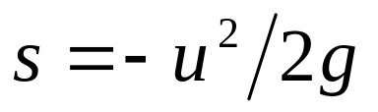
Why measurement?
The maximum height reached is
given by,
s
Here the role of measurement is to validate the theoretical predictions.

Slide 11
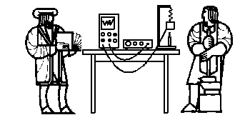
Why measurement?
May be true. But what is the use?!!
Strength of materials
Class
“stress is
directly
proportional to
strain within
the elastic limit”
To form empirical relation where no relation exists which can be derived from first principles

Slide 12
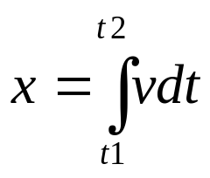
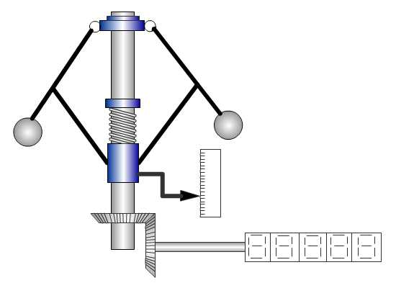
Why measurement?
Where,
x- distance, a function of time
v - speed, function of time
Fly ball mechanism
To give solutions to mathematical equations by means of analogies.

Slide 13
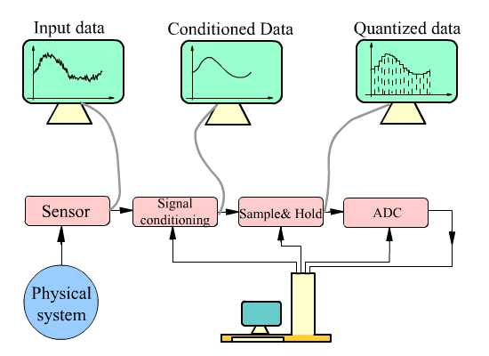
Why measurement?

Slide 14
Why measurement?
To monitor processes and operations through its parameters.
To control processes and operations.
Determination of material, component, system parameters, variables, and performance indices.
For practical verification of already established quantity.
To validate the theoretical predictions.
To form empirical relationships where no adequate theory exists.
To provide solution of mathematical equations by means of analogies.
To give inputs to computer aided machines and processes.

Slide 15

Why should you learn measurements?
Most of the engineering systems basically consist of three things
  Material
  Energy
  Signal

Slide 16
Why should you learn measurements?
If the signal system (measurement system) fails, then we loose control over energy and waste material. In all such engineering systems, measurements play a vital role.
An engineer needs to select a right instrument to measure a particular parameter.
In some experimental investigation and Industrial application a suitable instrument may not be available in the market. In that case, he needs to design an instrument.

Slide 17
Some Basic Questions (?)
What…?
When…?
How…?
It depends on the specific
application.
The rest of the subject is all
about answering this question.

Slide 18


What is an instrument?
An instrument is a device used for measurement, which is made up of basic functional blocks.

Slide 19
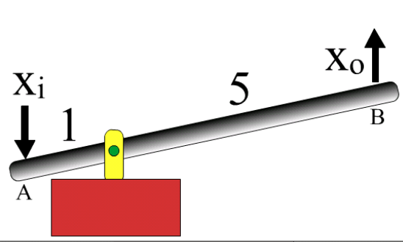
What is a basic functional block?
Basic functional block (BFB) is made up of elements, which cannot perform any function when the block is divided further in to sub blocks.
Eg: lever

Slide 20
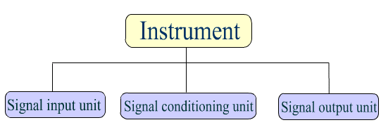
Generalized measurement system
The basic function of an instrument is to sense the variable, process it and present it to human observer. Any measurement system is made up of three basic units.

Slide 21
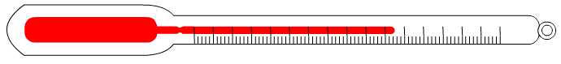
Identify the elements
Conditioning Element
Sensing Element
Display Element
Liquid bulb thermometer

Slide 22
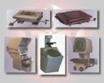
Types of instruments

Slide 23
Depending on domain
Mechanical instrument
Electrical instrument
Electronic instrument
Optical instrument
Hydraulic and pneumatic instrument

Slide 24
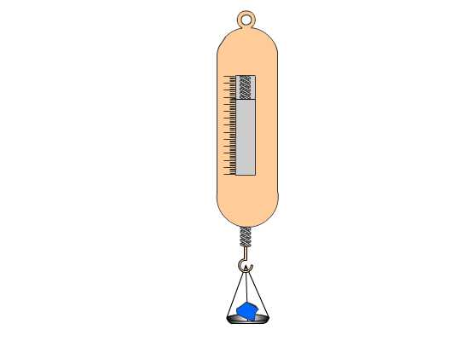
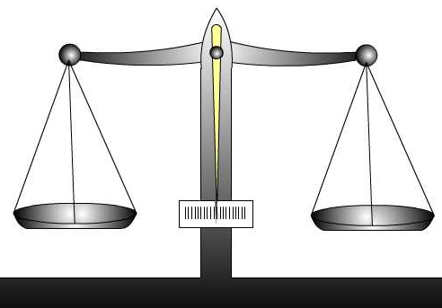
Depending on pointer movement
Null deflection instrument
Deflection instrument
Null deflection instrument
Deflection instrument

Slide 25
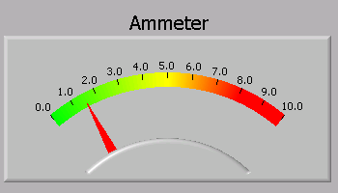
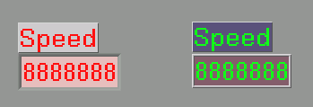
Depending on the display
Analog instrument
Digital Instrument
Hybrid instrument
Analog instrument
Digital instrument

Slide 26
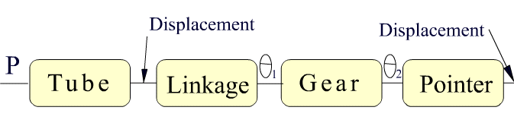
Depending on principle of functioning
Open loop instrument
Closed loop instrument
Pressure gauge

Slide 27
Summary
Measurement & why it is necessary
Why an Engineer needs to learn measurement
An instrument is & its basic functional block
Described GMS
Identified the various units of measurement system
Described different types of instruments

